Slide 1
The Event Photo Sharing through Full Stack Development

Slide 2
Mini project-2
Project Title - Event photo sharing
Name -
Bharat Sachdeva-H-2115000289
Dipesh Punyani-H-2115000373
Shivangi Srivastava-H-2115000958
Lakshya Arya-H-2115000584
Department- BTech-(CSE)

Slide 3
INTRODUCTION
An event photo sharing application is a platform or software that enables users to upload, share photos from a specific event .
Problem or motivation behind the project – It aims to address the challenge of efficient and effective sharing photos taken at events .
Motivation: Capture and preserve Memories, Convenience and Accessibility.

Slide 4
OBJECTIVE
"Event Photo Sharing" is a full stack development project focused on creating a user-friendly platform for seamless photo sharing during events. The objective is to enable attendees to effortlessly upload, share, and access event photos in real-time while prioritizing privacy, security, and cross-device compatibility.

Slide 5
Problem Statement
Problem Addressing:
In today's digital age, there is a growing need for a centralized platform that allows users to easily share and view photos from various events. Whether it's a wedding, a concert, a corporate gathering, or a community event, capturing and sharing memories has become an integral part of our social interactions.
Why is it important or relevant?
Developing an event photo sharing platform is relevant and important because it facilitates memory preservation, strengthens social connections, improves efficiency, promotes events, offers customization, and prioritizes user privacy and security.

Slide 6
Literature Review
Summarize in the same domain:
It helps to foster connection, support, and engagement among users. Such an app could serve as a platform for sharing moments of joy, seeking advice, or simply staying connected with friends and family.
Highlighting the gap our project is filling:
Our platform has successfully bridged the gap between individual memories and collective storytelling, creating a vibrant community of shared moments.

Slide 7
Methodology
The methodology for the "Event Photo Sharing" project involves:
Requirement Analysis: Understanding the needs of event attendees and organizers for effective photo sharing.
Design and Prototyping: Creating user-friendly interfaces for photo uploading, sharing, and access.
Backend Development: Implementing robust backend systems for data storage, retrieval, and real-time photo updates.
Frontend Development: Designing intuitive user interfaces for seamless navigation and interaction.
Testing and Iteration: Conducting rigorous testing to ensure functionality, usability, and security.

Slide 8
System Architecture
Present the overall architecture of your system:
Frontend Interface: This is the user-facing part of the system where attendees interact with the platform. It includes features for uploading photos, browsing photos, liking the image and commenting on it.
Backend Server: The backend server manages data storage, processing, and retrieval. It handles user authentication, photo uploads, database operations, and communication with other system components.
Database: The database stores all relevant data, including user profiles, photo metadata, event information, and access permissions. It should be designed for scalability, reliability, and efficient querying.

Slide 9
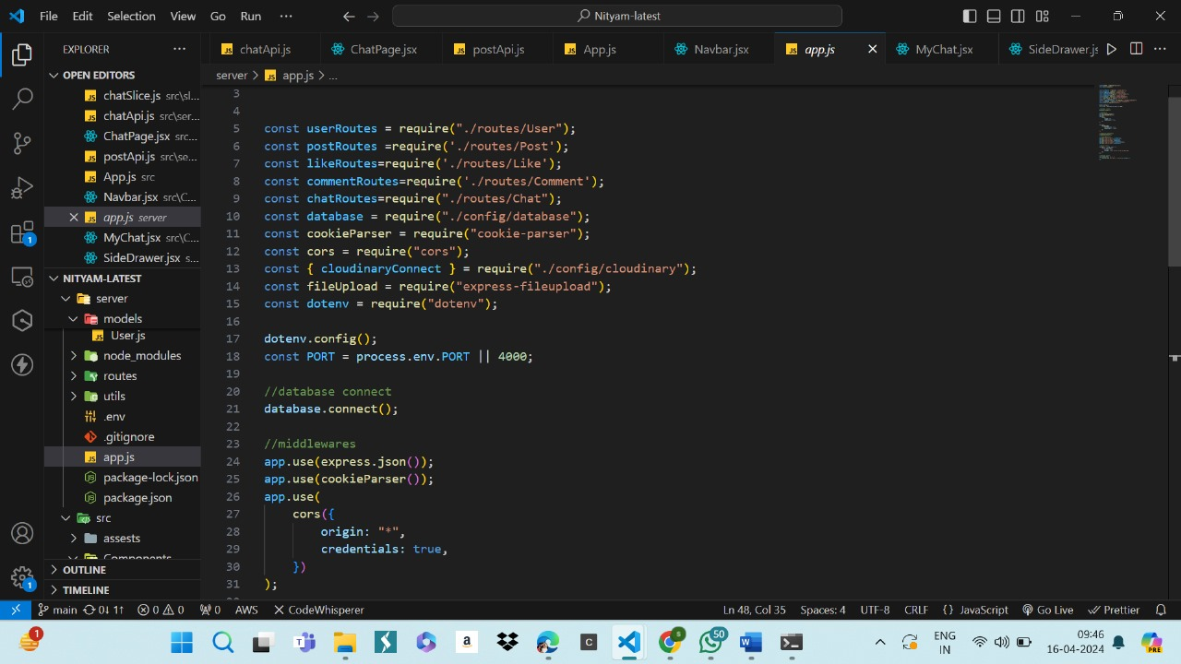
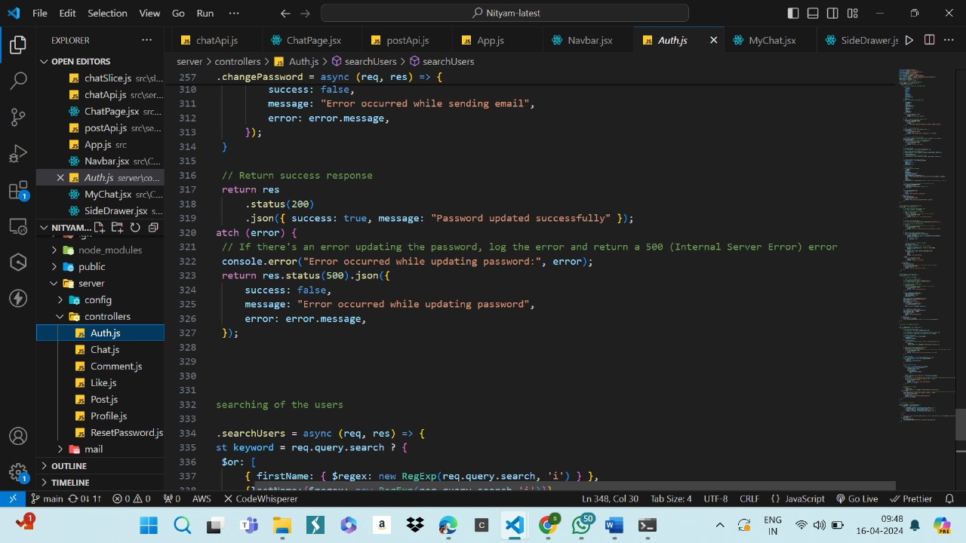
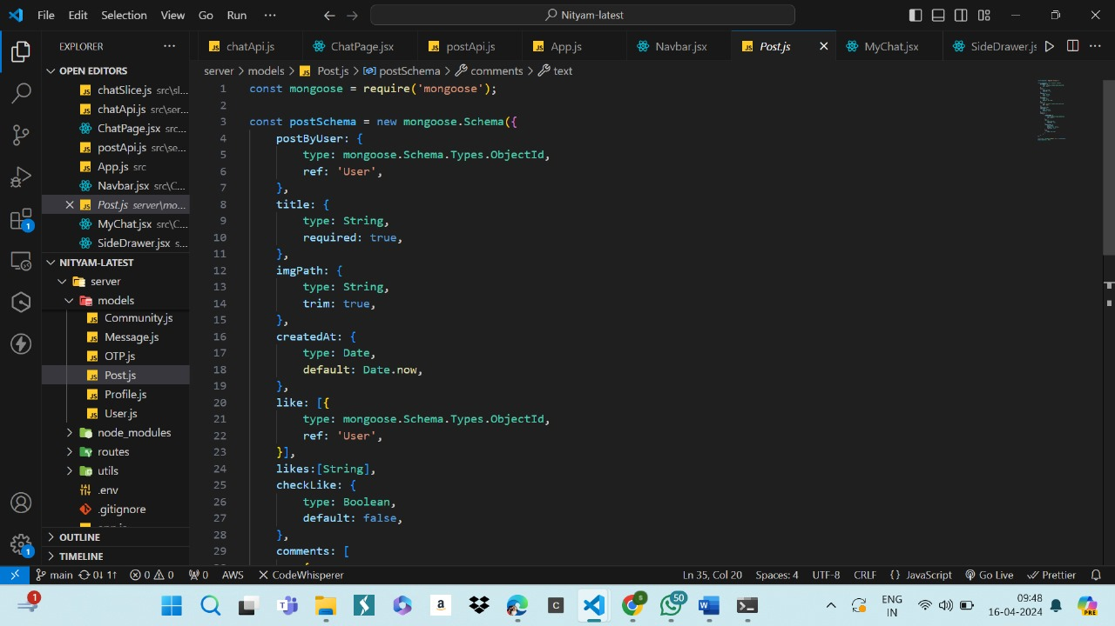
Implementation

Slide 10
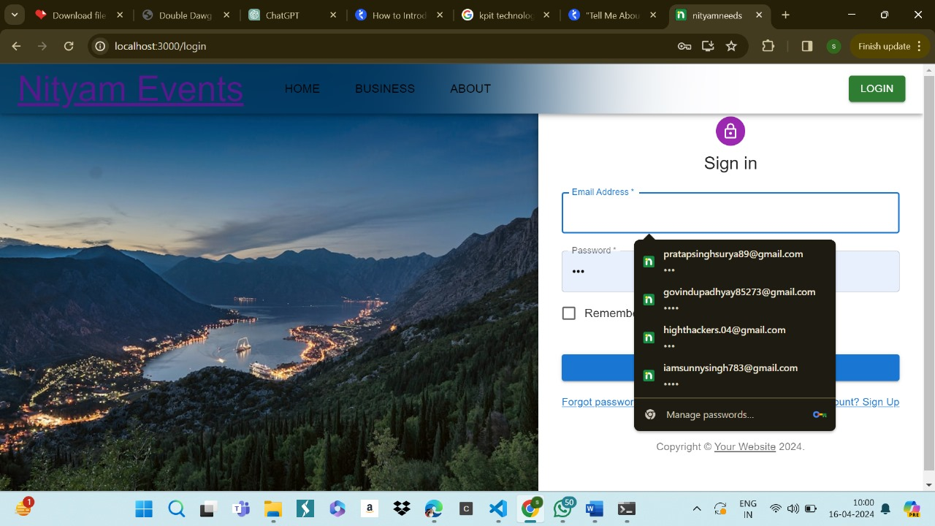
Implementation
Our Project look like this

Slide 11
Features
Highlight the key features of your project:
User Registration and Authentication
Photo Upload
Real-time Sharing
Privacy Controls
Social Sharing
Responsive Design

Slide 12
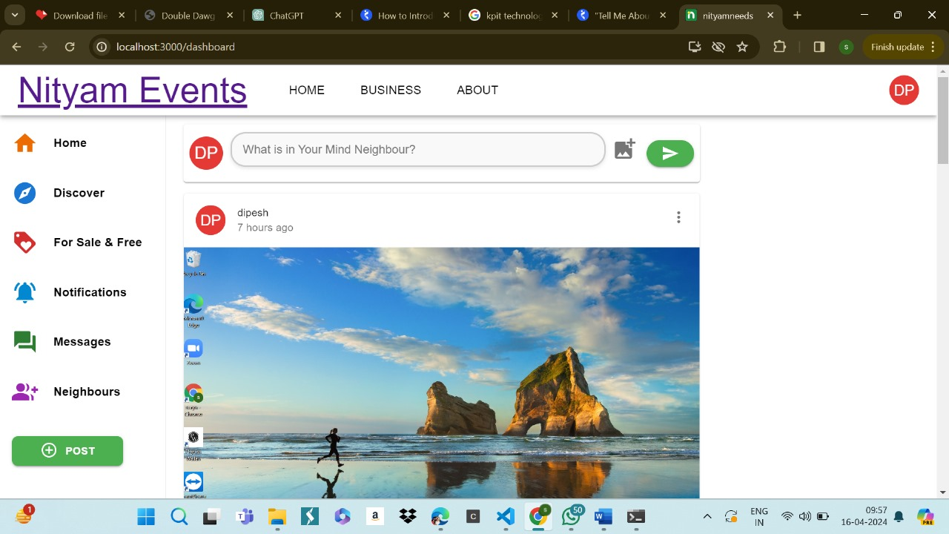
Results
Showcase the results or outcomes of your project

Slide 13
Challenges Faced
Discuss any challenges or obstacles encountered during the project:
One of the primary challenges is ensuring the app's usability and accessibility for a wide range of users, including those with varying levels of technical proficiency which require intuitive user interface.
Another challenge is managing the large volume of photos that users are likely to upload and share which involves implementing efficient storage and retrieval mechanisms.

Slide 14
Future Work
What could be done to improve or extend the project in the future?
AI-Powered Recommendation System
Enhanced Search & Discovery
Digital Library Integration
Social Features & Community Management
Enhanced Accessibility Features

Slide 15
Conclusion
Summarize the key points of your presentation:
Through Event Photo Share, attendees from various events have been able to upload their snapshots, weaving together a rich tapestry of perspectives that celebrate the diversity and uniqueness of each event.
Reiterate the significance of your project:
Our Event Photo Sharing System ease of access and the joy of reliving shared experiences have not only strengthened bonds but also created a repository of timeless memories.
Our Event Photo Share System stands as a testament to the power of community and the enduring value of shared experiences.

Slide 16
Acknowledgement
We would like to take a moment to express our sincere gratitude to Mr. Akash Kumar Choudhary for his mentorship ,guidance, and encouragement throughout this project. Your unwavering support and insightful feedback have been instrumental in shaping the direction of our work and ensuring its successful completion.

